Slide 1

Oracle OpenWorld & CodeOne Review Pillar 2: Application Development
Custom Application Development
Notes:
Fast data arrives in real time and potentially high volume. Rapid processing, filtering and aggregation is required to ensure timely reaction and actual information in user interfaces. Doing so is a challenge, make this happen in a scalable and reliable fashion is even more interesting. This session introduces Apache Kafka as the scalable event bus that takes care of the events as they flow in and Kafka Streams and KSQL for the streaming analytics. Both Java and Node applications are demonstrated that interact with Kafka and leverage Server Sent Events and WebSocket channels to update the Web UI in real time. User activity performed by the audience in the Web UI is processed by the Kafka powered back end and results in live updates on all clients.
Fast data arrives in real time and potentially high volume. Rapid processing, filtering and aggregation is required to ensure timely reaction and actual information in user interfaces. Doing so is a challenge, make this happen in a scalable and reliable fashion is even more interesting. This session introduces Apache Kafka as the scalable event bus that takes care of the events as they flow in and Kafka Streams for the streaming analytics. Both Java and Node applications are demonstrated that interact with Kafka and leverage Server Sent Events and WebSocket channels to update the Web UI in real time. User activity performed by the audience in the Web UI is processed by the Kafka powered back end and results in live updates on all clients. Introducing the challenge: fast data, scalable and decoupled event handling, streaming analytics Introduction of Kafka demo of Producing to and consuming from Kafka in Java and Nodejs clients Intro Kafka Stream API for streaming analytics Demo streaming analytics from java client Intro of web ui: HTML 5, WebSocket channel and SSE listener Demo of Push from server to Web UI - in general End to end flow: - IFTTT picks up Tweets and pushed them to an API that hands them to Kafka Topic. - The Java application Consumes these events, performs Streaming Analytics (grouped by hashtag and author and time window) and counts them; the aggregation results are produced to Kafka - The NodeJS application consumes these aggregation results and pushes them to Web UI - The WebUI displays the selected Tweets along with the aggregation results - in the Web UI, users can LIKE and RATE the tweets; each like or rating is sent to the server and produced to Kafka; these events are processed too through Stream Analytics and result in updated Like counts and Average Rating results; these are then pushed to all clients; this means that the audience can Tweet, see the tweet appear in the web ui on their own device, rate & like and see the ratings and like count update in real time

Slide 2

Low Code & High Code
Make JavaScript/HTML5/REST development simpler and more productive
Provide best-of-class tooling for modern JavaScript UI
Allow coders and low-code developers to work in harmony
Reduce IT backlog and build solutions faster

Slide 3


Oracle Java Extension Toolkit (JET)
Oracle JET is targeted at JavaScript developers working on client-side applications. It's a collection of open source JavaScript libraries along with a set of Oracle contributed JavaScript libraries that make it as simple and efficient as possible to build web and mobile applications that consume and interact with Oracle products and services, specifically Oracle Cloud Services.

Slide 4







Notes:
jQuery is provided for those that want to use it, but it’s definitely not required.
All UI components are wrapped as jQueryUI widgets. This allows a developer to reach out to the larger jQueryUI component repositories out there and use other components that they may not find in JET itself if they like.
Knockout is used for two-way data binding.
RequireJS is used for lazy loading of resources and the management of AMD (asynchronous module definition) modules.
JET is also designed for Mobile development, in which case we use Cordova for hybrid compilation.

Slide 5
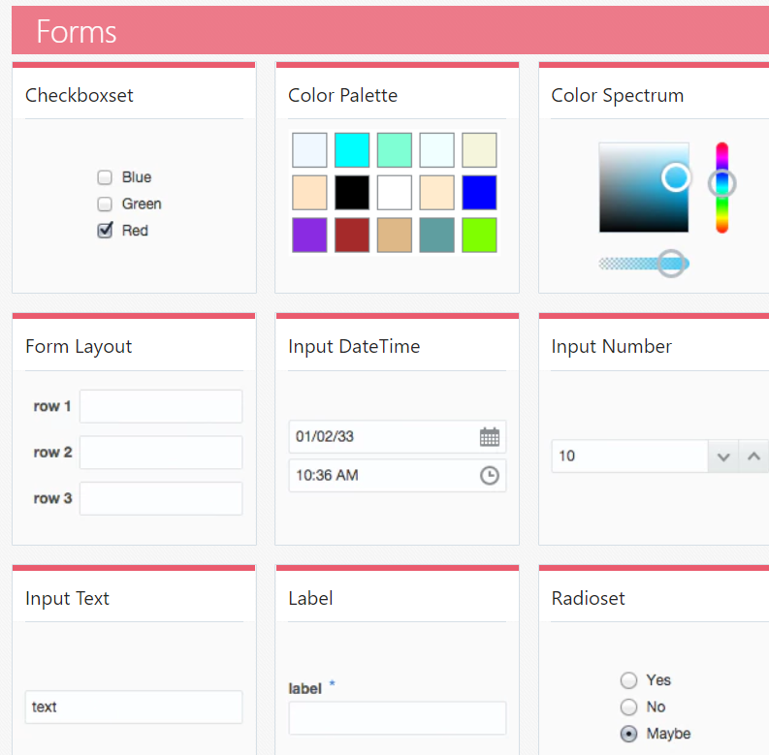
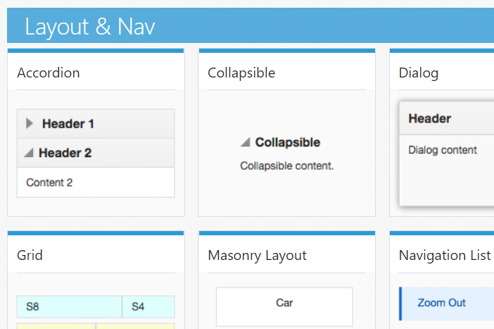
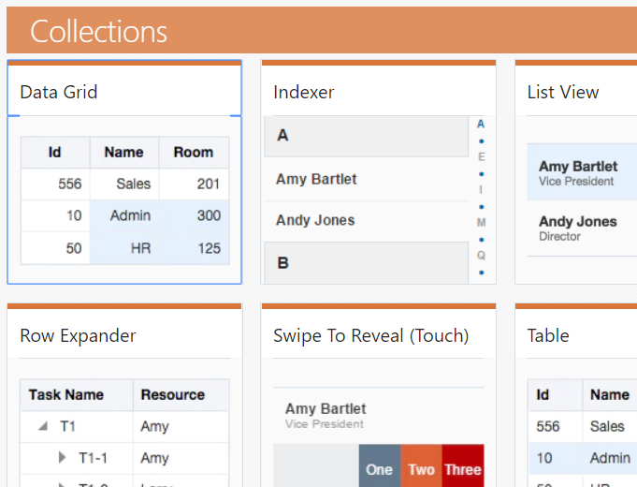
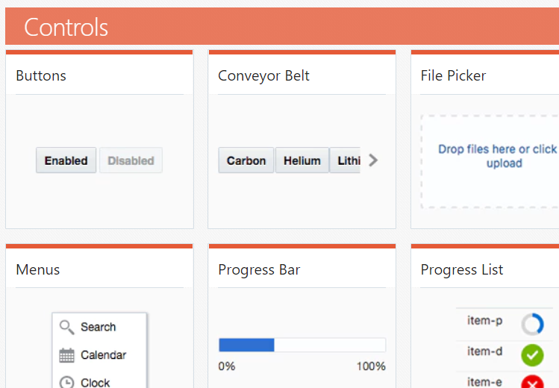
User Interface
Basic
Notes:
Basic UI components that anyone would expect to find.

Slide 6
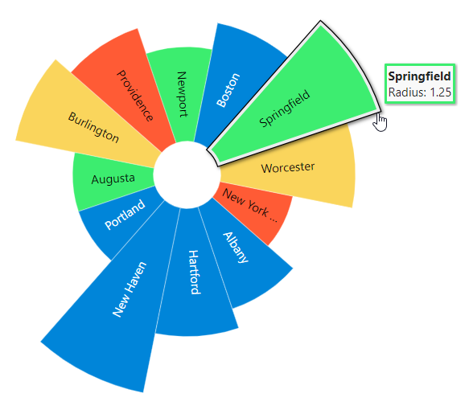
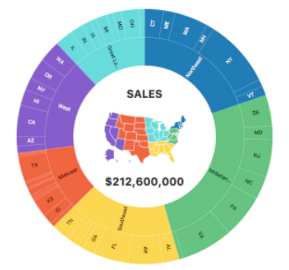
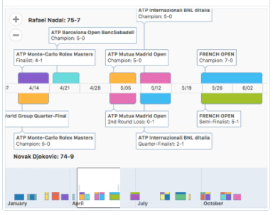
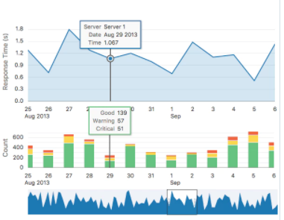
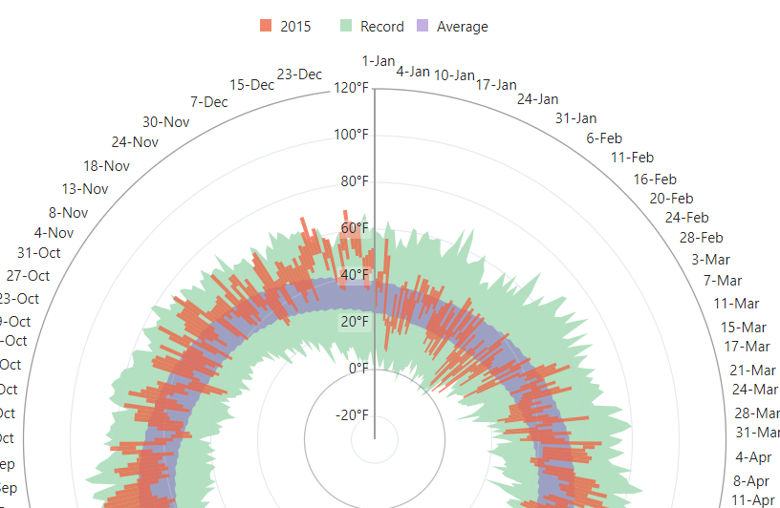
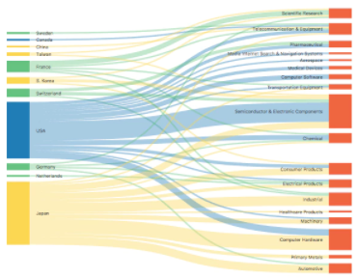
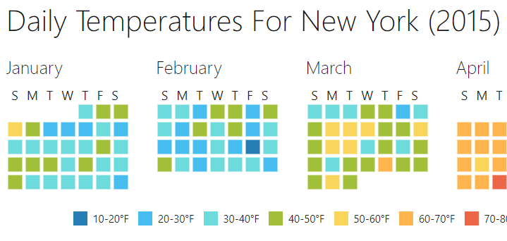
User Interface
Advanced
Notes:
Advanced UI components that can get very complex. The Oracle BI Visual Analyzer product uses Oracle JET charts for their scientific data analysis.

Slide 7
Oracle JET - Value Proposition
Enterprise ready - built-in accessibility, security, internationalization
Rich components set - including data visualization
Advance routing - for single page applications
Common model – for simplified data binding with web services
Built-in responsive UI - at both the CSS and JS level
Fully Open-Source - leverage existing skills and community knowledge
Modular architecture – use what you need, lightweight and fast
Optimized for Oracle customers – Supports Oracle Alta UI and Oracle REST
Notes:
What Oracle bring to the toolkit

Slide 8

Oracle JET Architecture
Web Components
View
Oracle JET UI Components (Web Components)
Oracle JET Routing
JQueryUI (deprecated)
Hammer
SASS
CCA
RequireJS
View-Model
Abstracted Binding
Model
Oracle JET Common Model API
XHR
AJAX
Web Socket
Client
Web Services
Server

Slide 9

JET 6.0.0 GA – Oct 15th, 2018
Features & bug fixes delivered every two months since October 2014
JET 6.0.0 is our 23rd on-schedule release
Oct 2014
Feb 2016
Aug 2016
Sept 2017
Apr 2018
Jun 2018
Aug 2018
Oct 2018
JET 1.0.0
v0.5
JET 2.0.0
JET 2.1.0
JET 4.0.0
JET 5.0.0
JET 5.1.0
JET 5.2.0
JET 6.0.0
Open Source release!
Move to SemVer
Major release
Minor release – Bug fixes
Web Comp. intro
Next Major
1st internal release

Slide 10
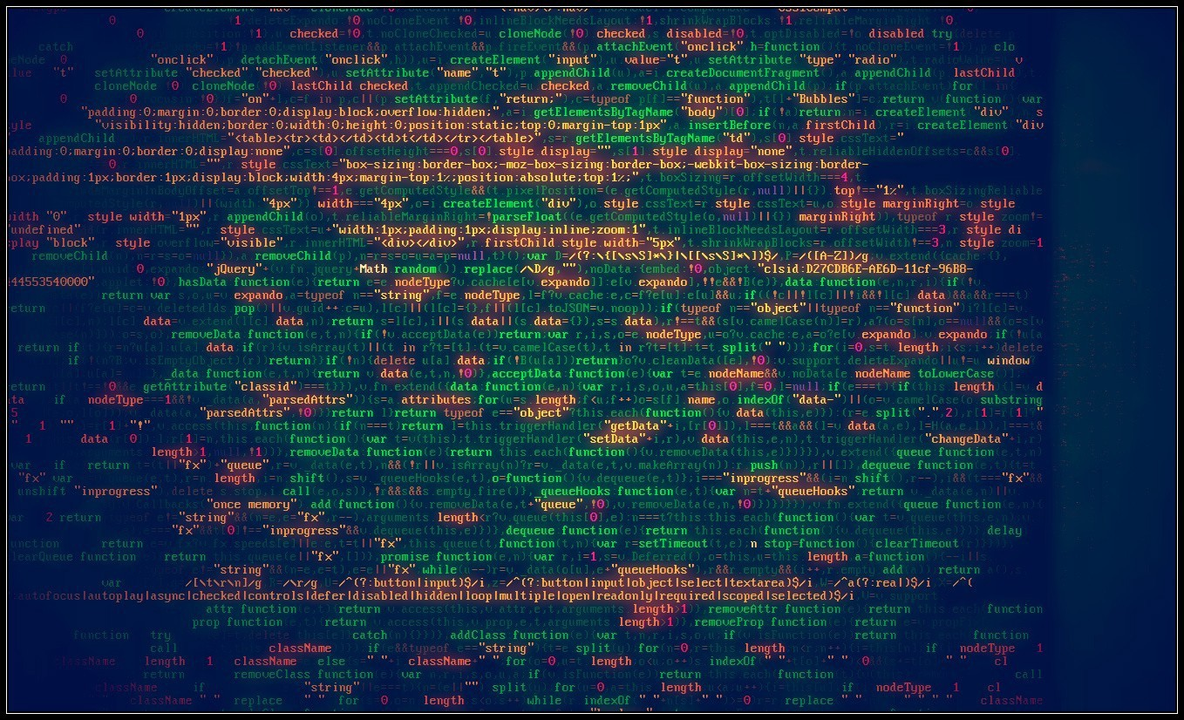
High Code - What’s The Problem?

Slide 11
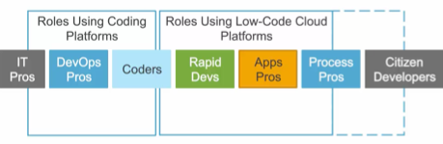
Developers Spectrum

Slide 12

Oracle Visual Builder Cloud Service
Build and host web and mobile applications in a faster and simpler way with zero install and visual development experience

Slide 13
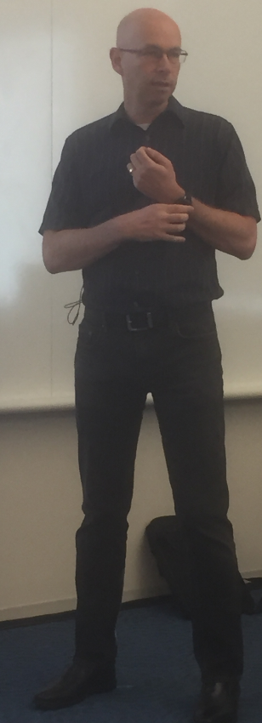
What Is VBCS?
Oracle JET JavaScript Toolkit
A rapid application development environment for that toolkit
A deployment platform that hosts the apps you
A database for custom business objects
REST connections for connecting to remote data
Integration with IDCS/SIM for security and SSO with Oracle Cloud
Integration with the rest of the Oracle SaaS/PaaS platform for additional functionality
CRM, HCM, Integration Cloud connectors, Process Cloud processes, Content Cloud documents, etc.

Slide 14
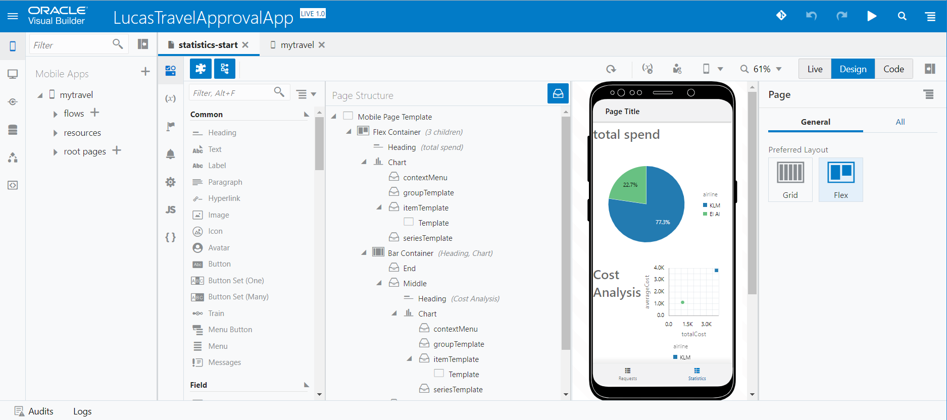
Visual Builder

Slide 15
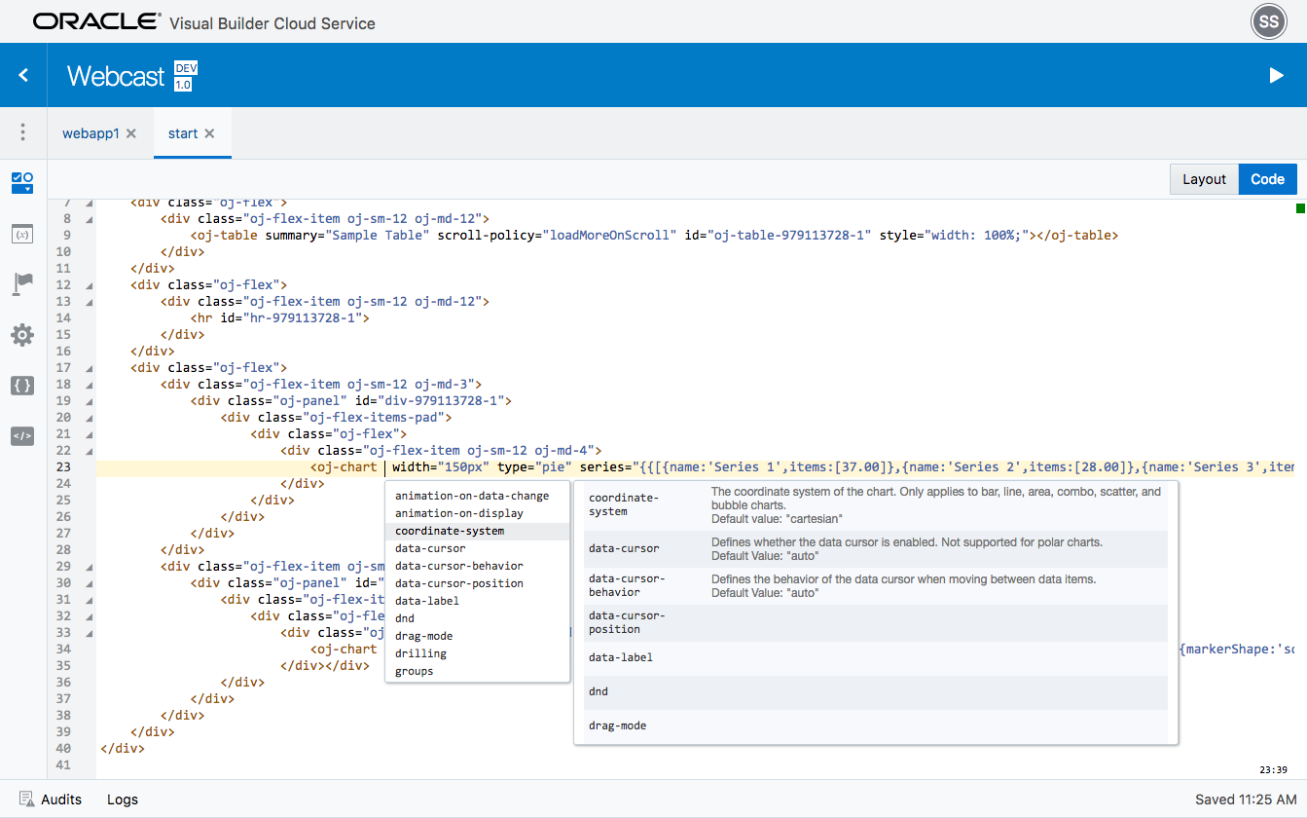
Flexibility Through Coding
Directly access code
Add your own logic
Extendable platform
UI Components
JavaScript Libraries
Styles

Slide 16
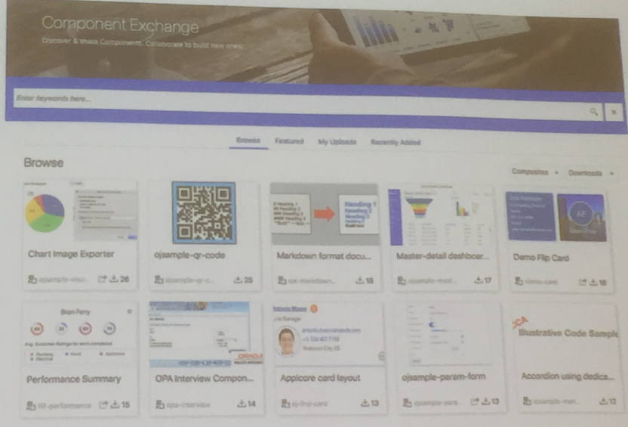
Visual Builder
JET Web Component Exchange
PCS Integration
Translation Support
Connection Catalog
Easily consume APIs from SaaS and … Oracle Integration Cloud
Not yet from API Platform
Developer Cloud integration
Use Git under Developer Cloud for source code control
Mobile support plus: Progressive Web Apps (PWA) – november 2018
Portable Visual Builder applications –
can run fully standalone (no Cloud access required)
CDN deployment

Slide 17
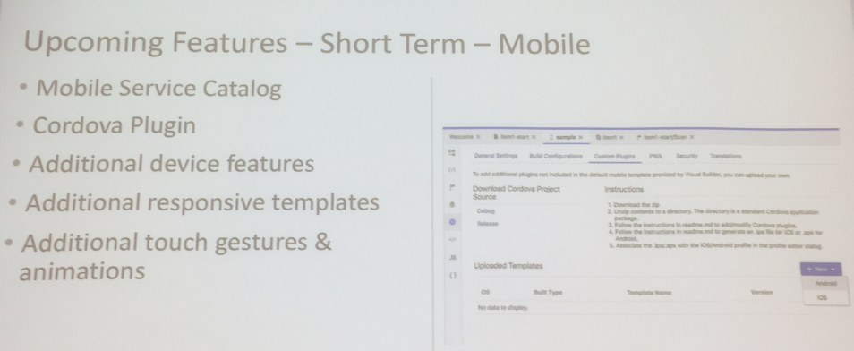
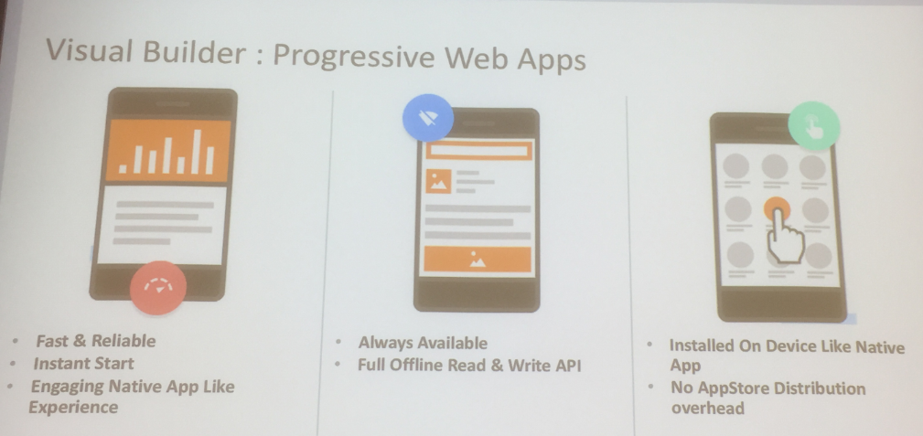

Slide 18
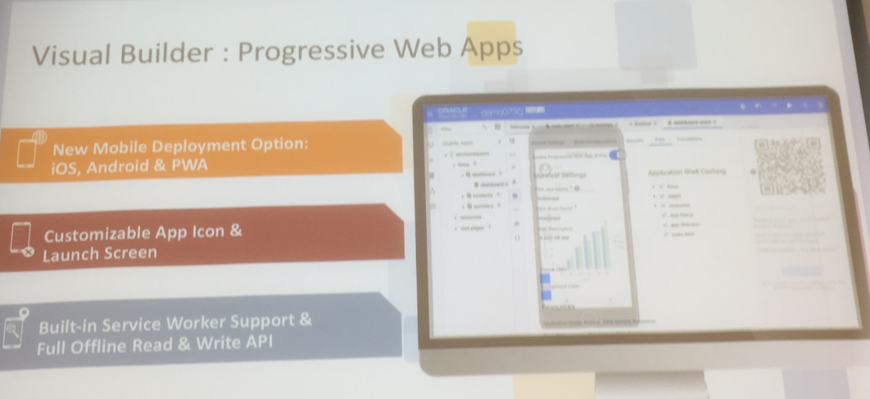

Slide 19
Digital Assistant

Slide 20
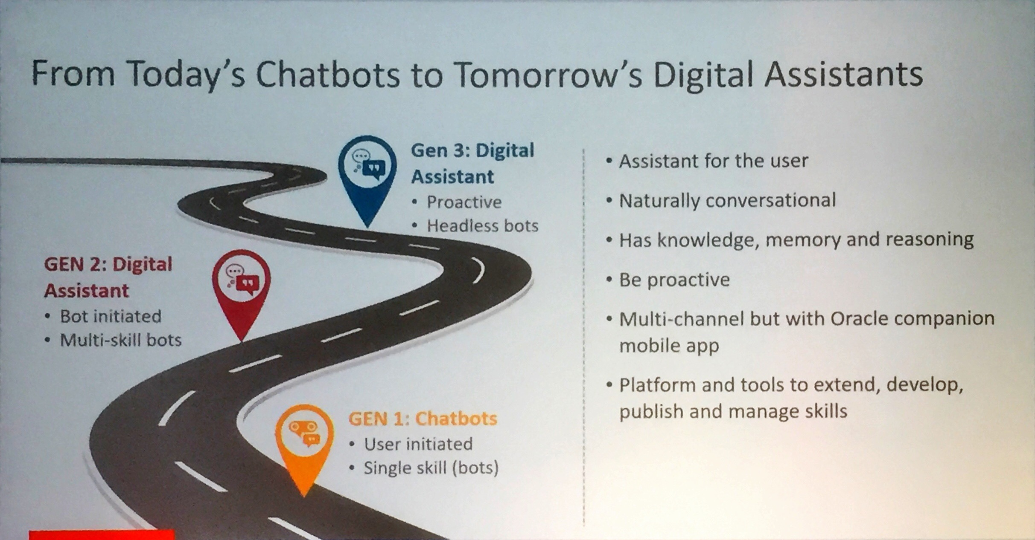

Slide 21
Conversation UI & Digital Assistant
entities
intents
flows
Conversation state
Type
Voice to Text
Next:
Update state
Fetch Ask/Display
Human
Text to Structure (NLP)
State Machine
speak
utterance

Slide 22
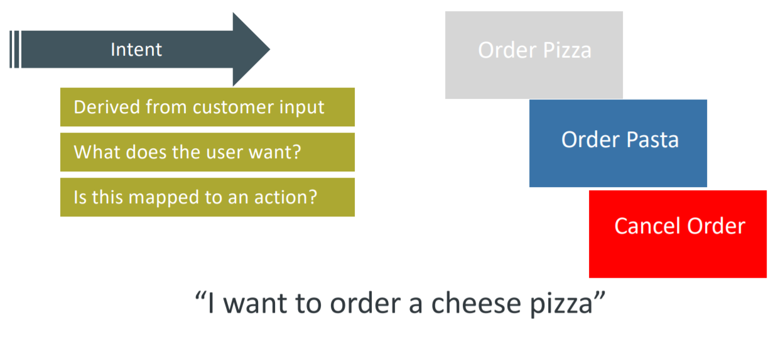
Intents
Known steps for a user to take

Slide 23
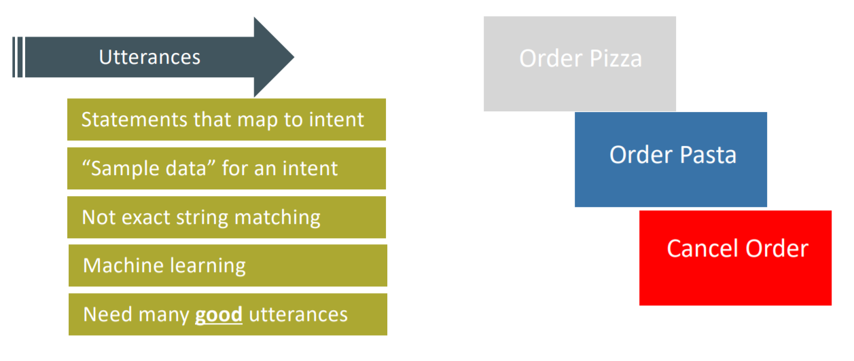
Intent is derived from utterance

Slide 24
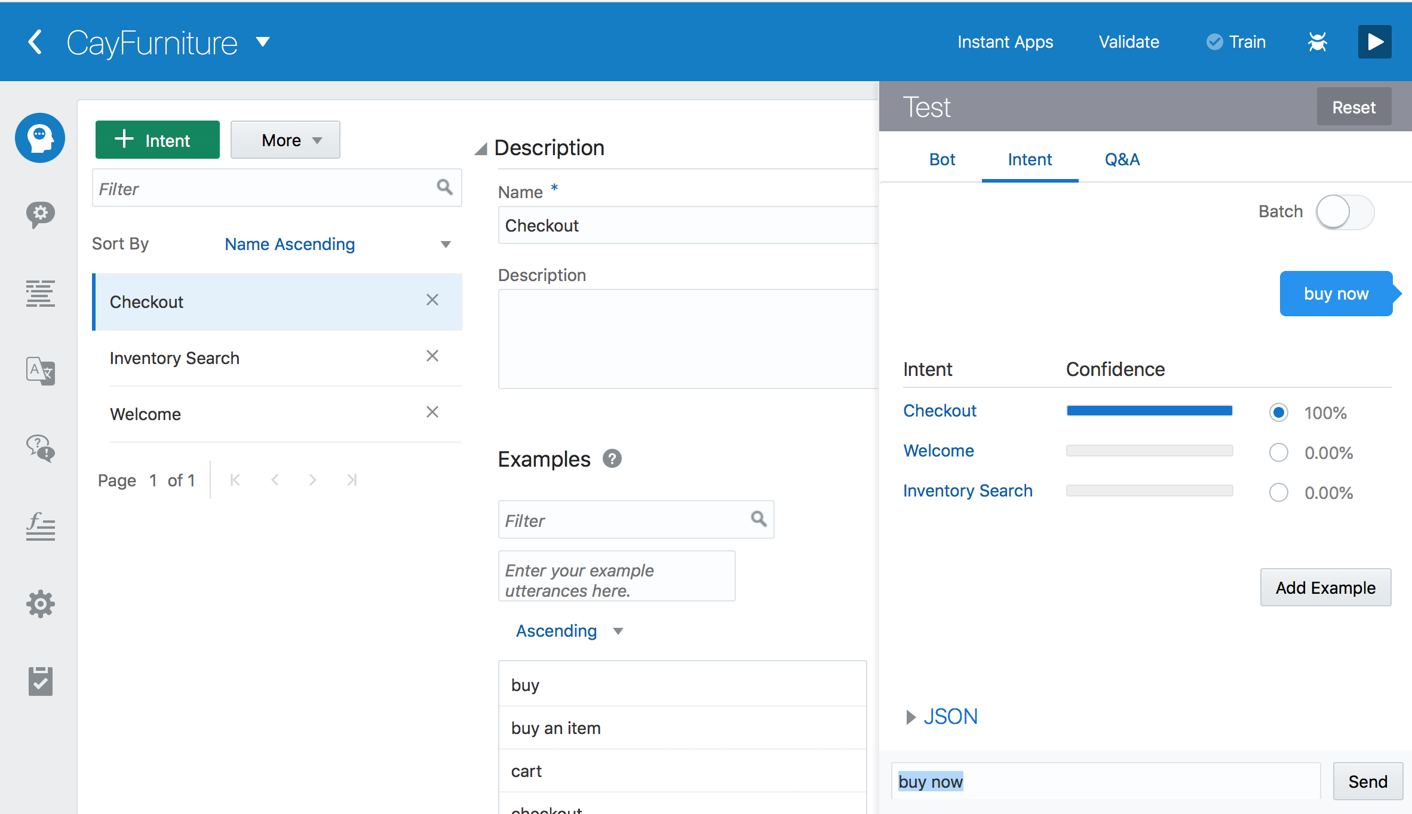
Oracle Digital Assistant Cloud Platform
Simulator
Intents
Utterances
Train ML

Slide 25
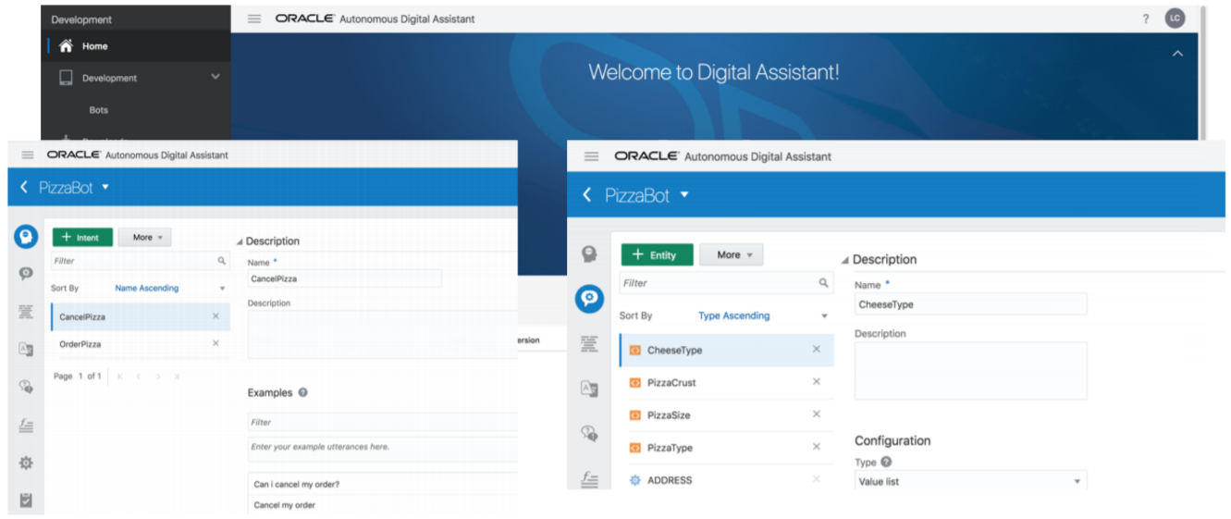
Oracle Digital Assistant

Slide 26
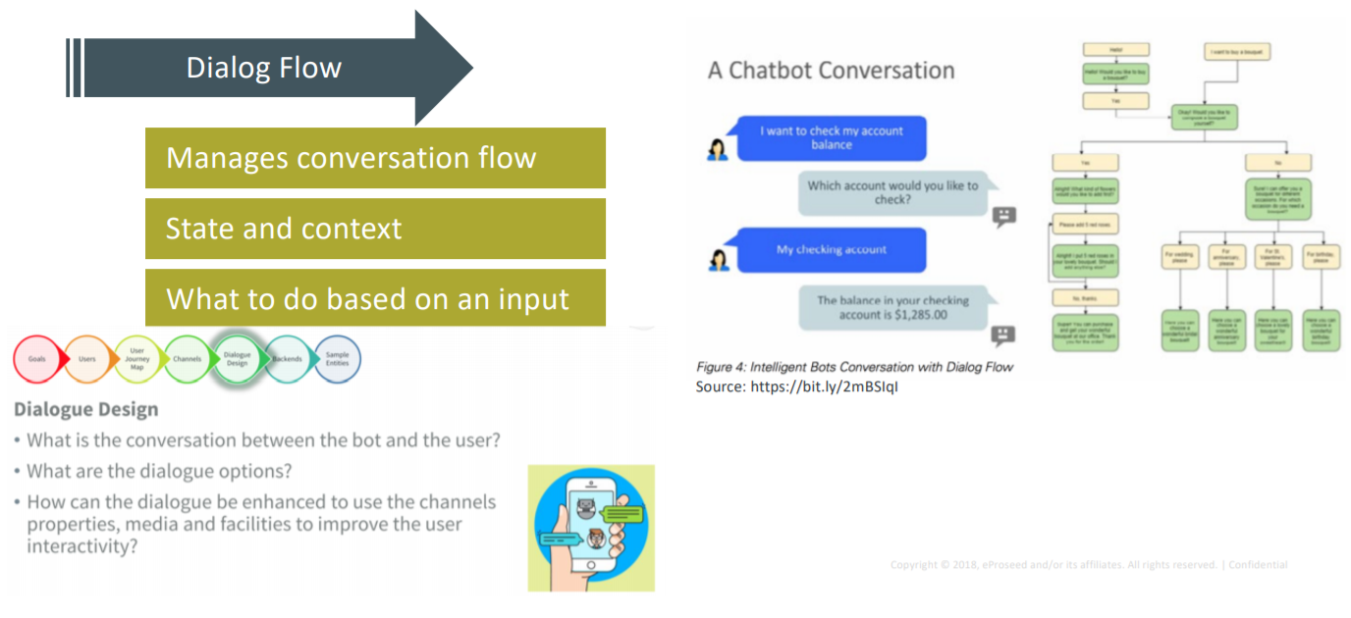
Dialog Flow
The workflow from state to state

Slide 27
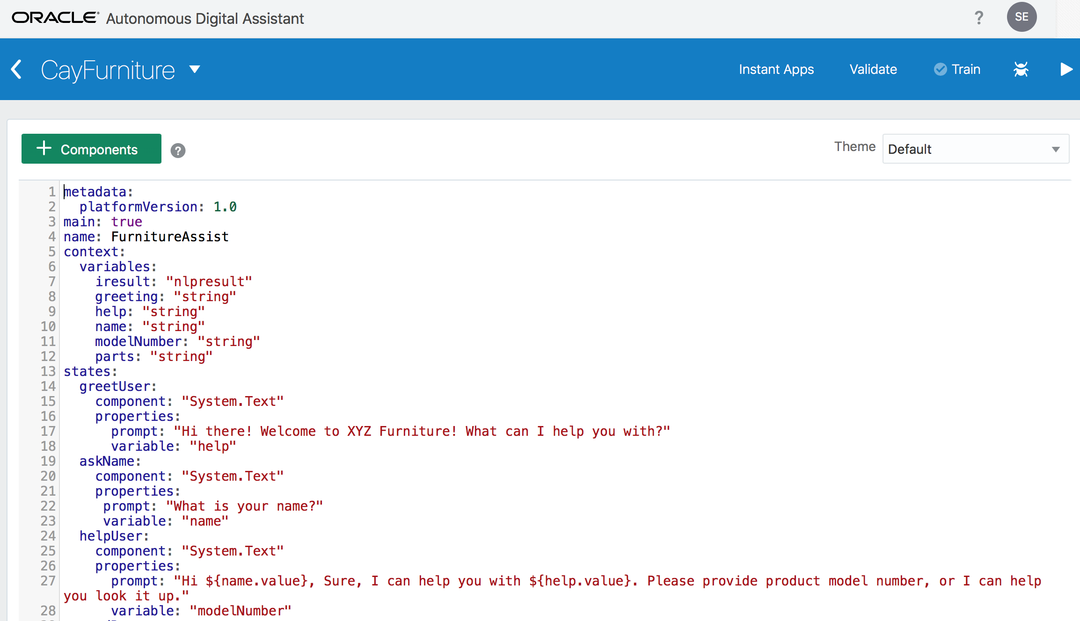
Heart of Chatbot : Declarative Interaction
OBotML

Slide 28
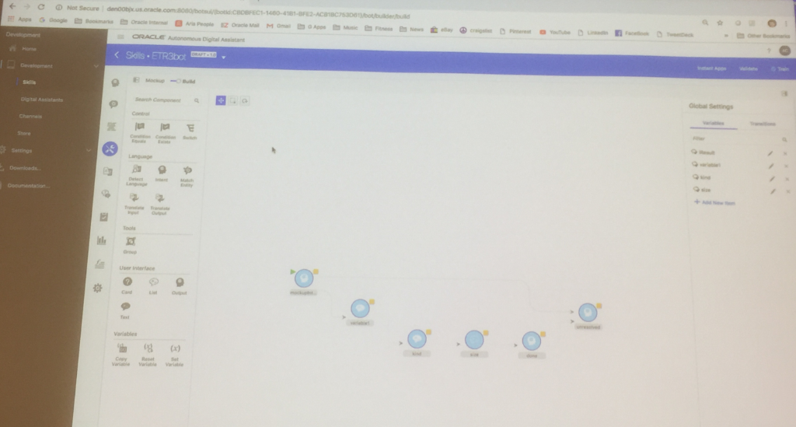
Visual Conversation Designer

Slide 29
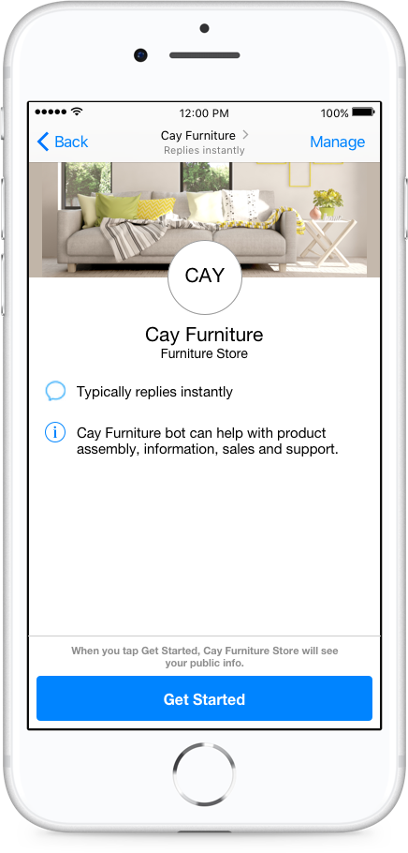
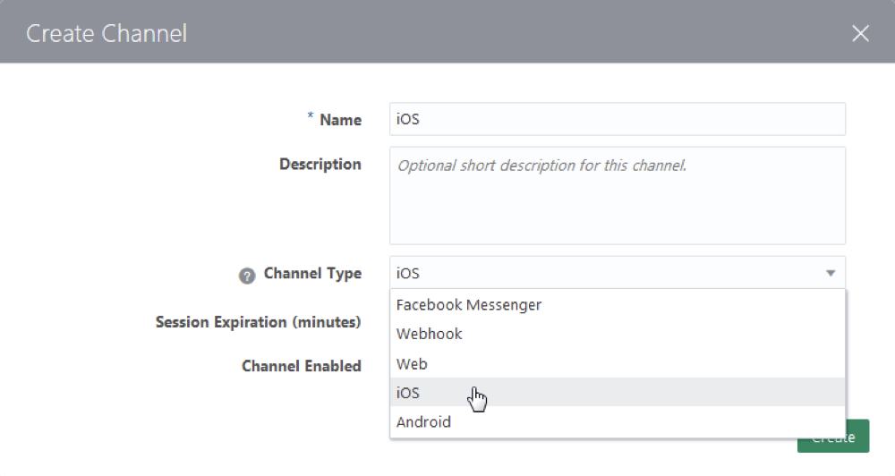
Deployment : Configure Facebook Messenger

Slide 30
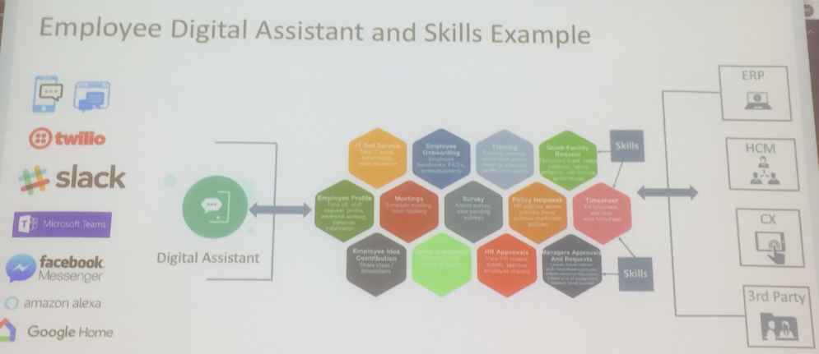
One Multichannel Digital Assistant combining many Skills

Slide 31
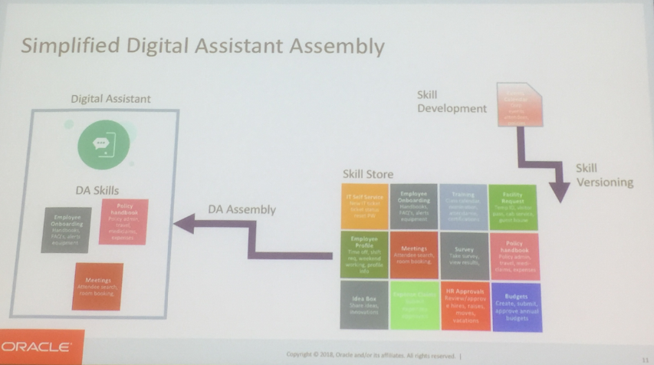
Future Vision: Assemble Digital Assistant from Skill Catalog

Slide 32

Digital Assistant Cloud
Visually design dialog through prototyping (“citizen chatbot developer”)
Bundle conversations (skills) in one Digital Assistant
Allow jumps between skills – while retaining context (state)
Integrate with
Slack, Skype for Business, Twillio, WhatsApp, Facebook Messenger
Alexa
Out of the Box Skills & Skills Store
Multi Language
Leverage Google Translate or Microsoft Translator Services

Slide 33
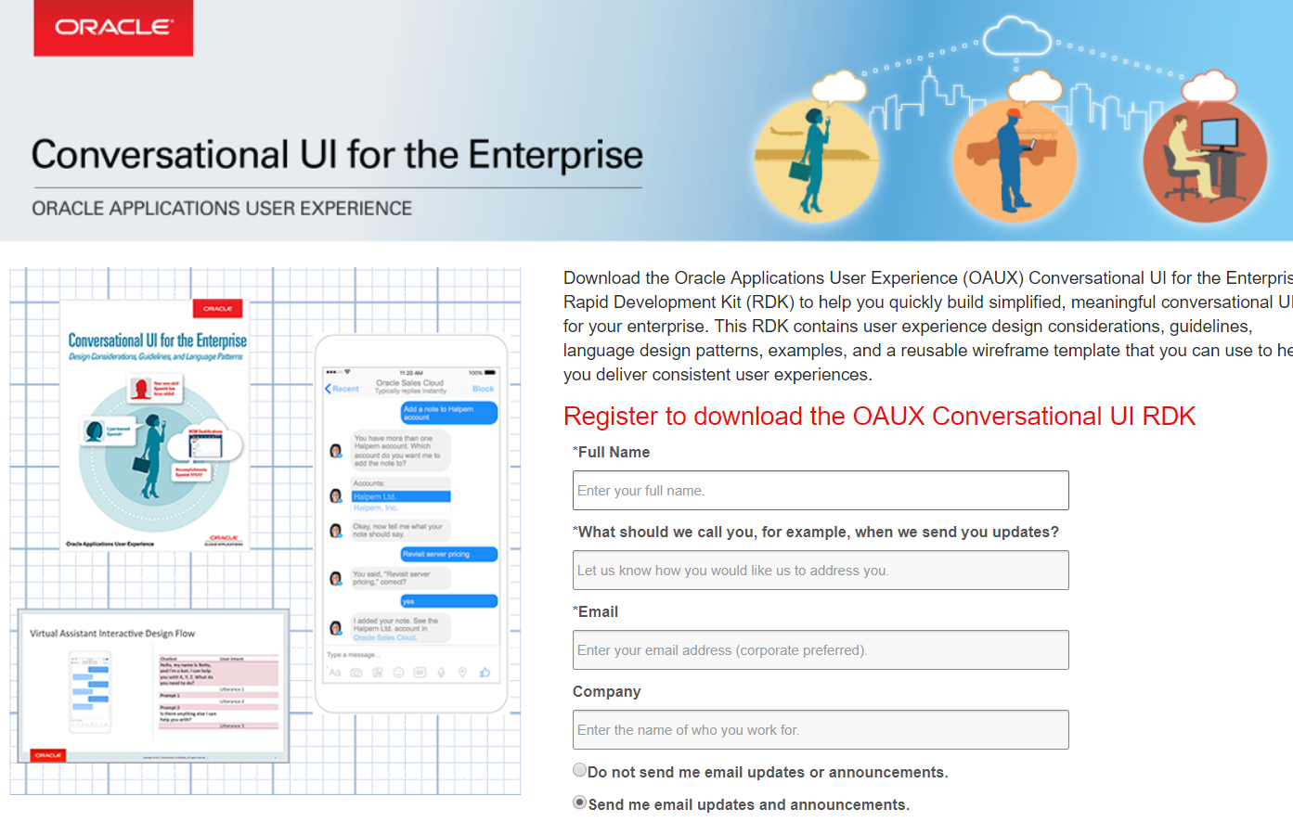
RDK for Conversational UI
http://tinyurl.com/OAUXConversationalUI
Notes:
http://tinyurl.com/OAUXConversationalUI

